Slide 1
Poetry
“Painting is silent poetry, and poetry is painting that speaks.”
– Plutarch (Greek historian, later became Roman citizen)

Slide 2
Just What is Poetry?
What are some types of poetry that you know?
What is the rhythm and rhyme in those poems?
How does poetry make you feel?

Slide 4
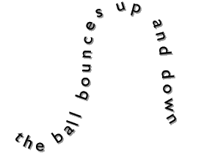
Concrete Poems
The Ball
The Snake
The Flower

Slide 5
Brainstorm Words About Your Subject
orange red
tall yellow
thin falling
thick losing
blanket shades
brown swaying
resting fall

Slide 6
Circling Your Word Choices
orange red
tall yellow
thin falling
thick losing
blanket shades
brown swaying
resting fall

Slide 7
This is the FORM of your poem
Use your descriptive words to create your shape poem.
Examples to follow…

Slide 8
Example of a “Leaf” Concrete Poem:

Slide 9
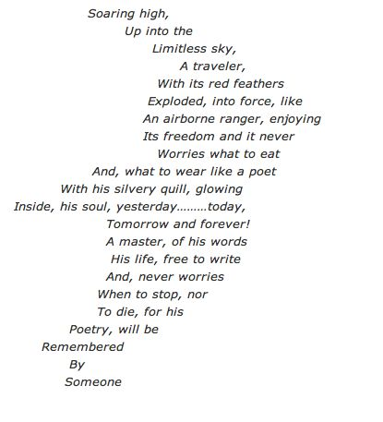

Slide 10
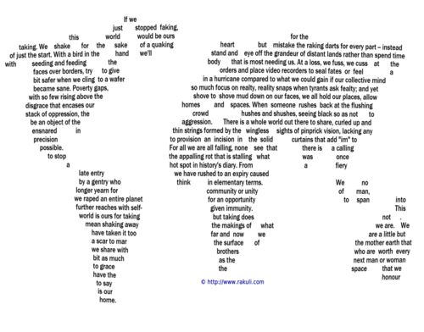

Slide 11
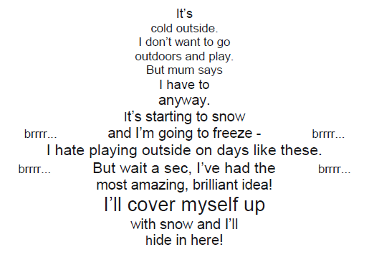

Slide 12
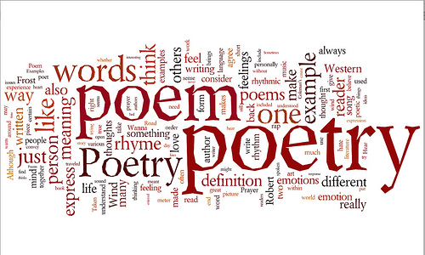
But what is the structure of concrete poetry?
FREE VERSE!
Definition: No rules! → No rules regarding form, rhyme, or rhythm.

Slide 13
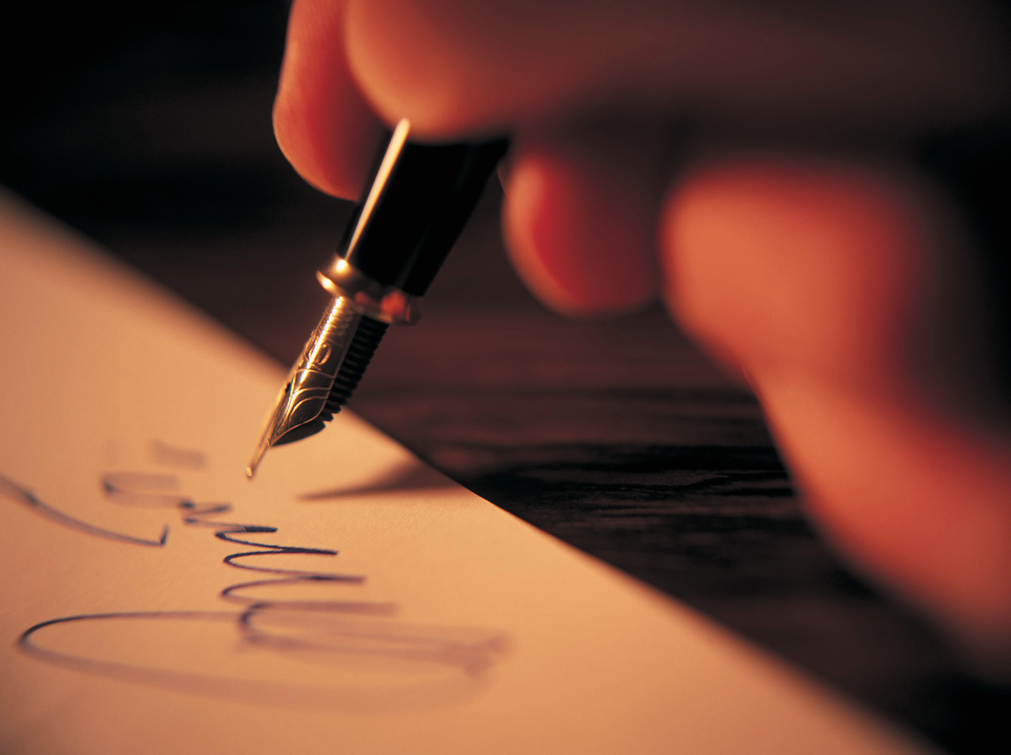
Now it’s YOUR turn!
What is your VERSE?

Slide 14
Tips: Carefully chosen words can help you create a poem that sounds like the situation, emotion, or object you are trying to portray.
Short words with sharp consonants cause the reader to stop-and- go in a choppy rhythm: Cut, bash, stop, kick, lick, bite, punch, jump, stick, kiss. Use these types of short words when you want to show excitement.
Longer words with soft sounds cause the reader to slow down. Use them when you want to show pause, tension, laziness, rest.

Slide 15
Some Poetic Devices…
Alliteration: The repetition of initial consonant sounds.
Assonance: The repetition of vowel sounds.
Imagery: Words or phrases that appeal to any sense.
Metaphor: A comparison between two objects with the intent of giving clearer meaning to one of them.

Slide 16
Onomatopoeia: The use of words, which imitate sound.
Personification: A figure of speech, which endows animals, ideas, or inanimate objects with human traits or abilities.
Repetition: The repeating of words, phrases, or lines.
Simile: A comparison between two objects using a specific word or comparison such as “like,” “as,” or “than.”
Rhyme: The similarity of ending sounds existing between two words.

